Slide 1

FREE FIRE

Slide 2


INTRODUCTION:
Free Fire is a popular online multiplayer game where players purchase various in-game items such as skins, diamonds, weapons, and characters.
These purchases generate a large amount of sales data every day across different regions.
Analyzing this data manually is difficult and time-consuming.
So, a Power BI dashboard is used to convert raw sales data into meaningful insights.

Slide 3

PROBLEM STATEMENT:
Free Fire sales data contains a large volume of information
Products, Regions, Sales, Profit, Sales Targets
Without proper visualization:
Sales trends are difficult to understand
Region-wise performance comparison is unclear
High-profit and low-profit products are hard to identify
Sales target achievement cannot be tracked easily
Manual analysis:
Is time-consuming
Can lead to incorrect business decisions Therefore,
An interactive Power BI dashboard is required
To analyze and present sales data in a clear and visual format

Slide 4

DATASET OVERVIEW
The dataset represents Free Fire sales performance data
It contains information related to:
Product Name
Product Category (Skins, Diamonds, Weapons, Characters, etc.)
Region (India, Philippines, Brazil, Indonesia, etc.)
Date of Sales
Total sales
Total profit
Units sold
Sales Target and Target Achieved
The dataset is structured into multiple related tables
Data is imported from Excel into Power BI
The dataset is used to analyze sales trends, profit performance, and target achievement

Slide 5


Duplicate records were identified and remove
The free fire sales data was cleaned using power query in power bi
Incorrect and missing values were checked and handle
DATA CLEANING & DATA TRANSFORMATION
Column name were renamed for better understanding
New calculated fields & measure were create for:
Total sales,total profit, Total units sold, Target achievement
Data types were properly set
Sales, profit $→$ numeric
Date $→$ date format

Slide 6
Schema used:
Star schema
Relationship type:
One-to-many (1:*)
Total tables used: 4 (free fire 1, free fire 2, free fire 3, free fire 4)
Filtering and analysis work properly using this model
DATA MODELING
Tables are connected using common fields
Transaction_ID, Date, Region
One main table is connected with multiple related tables
This data model helps to create accurate reports and dashboards

Slide 7

TECHNOLOGY USED
EXCEL
Used as the data source
Stores free fire sales dataset
DAX
Used to create calculated measures
Examples: total sales, total profit, units sold, target achievement
POWER BI
Used for data cleaning & transformation
Used for data modeling and relationship creation
Used for create interactive dashboard & repords

Slide 8
BUSINESS QUERIES
what is the total sales, total profit, and total units sold across all regions?
How does monthly sales trend change over time?
Which product category contributes the most to total sales?
Which regions perform better in terms of total sales?
What is the sales and profit comparison for each product category?
How is total sales distributed across different regions?
Which products generate hige profit and low profit?
Is the sales target achieved or not?
How does sales performance very when a specific region is selected using slicers?

Slide 9

KEY METRICS
TOTAL SALES
Shows the overall sales value generated from free fire products
TOTAL PROFIT
Displays the total profit earned from all sales
TOTAL UNITS SOLD
Represents the total number of units sold across all products
SALES TARGET ACHIEVEMENT
Shows how much of the sales target has been achieved

Slide 10
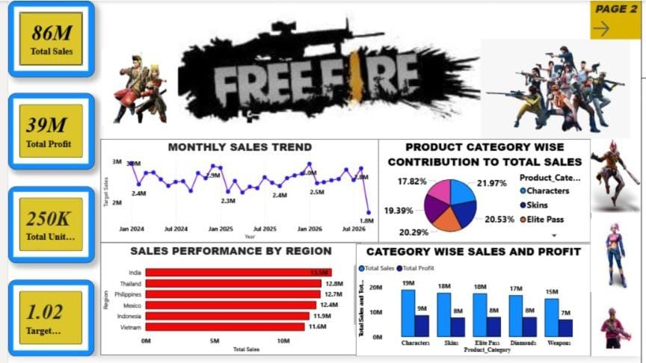

Slide 11
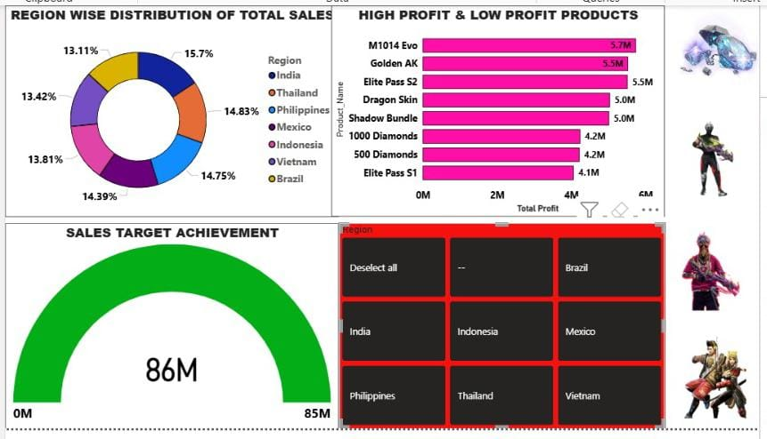

Slide 12

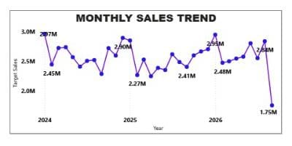
HOW DOES MONTHLY SALES TREND CHANGE OVER TIME
Why this chart?
Line chart is used to analyze sales trends over time
It shows monthly increase and decrease clearly
EXPLANATION:
The chart represents monthly total sales from 2024-2026
Some months record higher sales around 2.9M – 3.0M
Lowest sales are around 1.8M
Overall sales show a moderate upward trend
CONCLUSION:
This trend helps identify peak & low sales periods
Useful for forecasting, planning promotions, and improving sales strategy

Slide 13

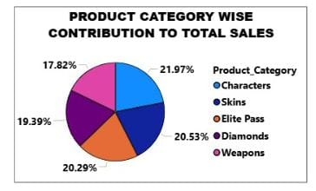
WHICH PRODUCT CATEGORY CONTRIBUTES THE MOST TO TOTAL SALES?
WHY THIS CHART:
Pie chart is used to show category-wise contribution to total sales
It helps compare percentages share of each product category
EXPLANATION:
The chart represents contribution of different product categories
Characters category contributes the highest share of total sales
Other categories like Skins, Elite Pass, Diamonds, and Weapons contribute moderately
This shows strong customer preference for Characters
CONCLUSION:
Characters is the top-performing product category
Focusing on this category can help maximize overall sales revenue

Slide 14

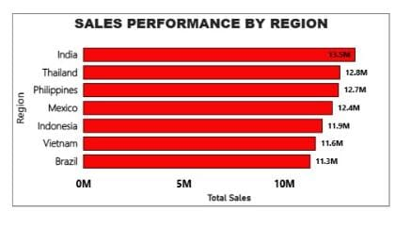
Which regions perform better in terms of total sales?
Why this chart?
❖ Bar chart is used to compare total sales across different regions
❖ It clearly highlights high-performing and low-performing regions
EXPLANATION
❖ The chart represents region-wise total sales performance
❖ India records the highest total sales among all regions
❖ Thailand and Philippines also show strong sales performance
❖ Regions like Indonesia and Vietnam have comparatively lower sales
CONCLUSION
❖ India is the best-performing region in terms of total sales
❖ Region-wise analysis helps identify key markets for business growth

Slide 15

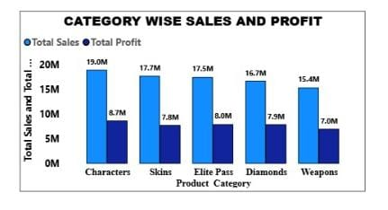
What is the sales and profit comparison for each product category?
Why this chart?
❖ Clustered column chart is used to compare sales and profit side-by-side
❖ It helps understand profitability of each product category
EXPLANATION
❖ The chart compares total sales and total profit for each product category
❖ Characters generate the highest sales and profit
❖ Skins and Elite Pass show good sales but relatively lower profit margins
❖ Weapons record the lowest sales and profit
CONCLUSION
❖ Product categories contribute unequally to sales and profit
❖ This comparison helps identify high-revenue and high-profit categories
❖ Useful for pricing and product strategy decisions

Slide 16

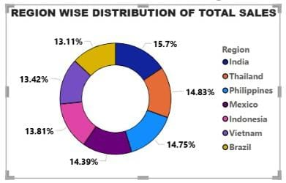
How is total sales distributed across different regions?
Why this chart?
❖ Donut chart is used to show percentage distribution of total sales
❖ It helps compare regional contribution to overall sales
EXPLANATION
❖ The chart represents region-wise distribution of total sales
❖ India contributes the highest share of total sales
❖ Other regions like Thailand, Philippines, and Mexico show moderate contribution
❖ Sales are fairly distributed across all regions
CONCLUSION
❖ India is the largest contributor to total sales
❖ Region-wise distribution helps identify key and emerging markets

Slide 17

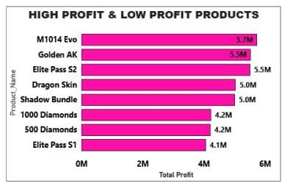
Which products generate hige profit and low profit?
Why this chart?
❖ Bar chart is used to compare profit across different products
❖ It clearly highlights high-profit and low-profit products
EXPLANATION
❖ The chart shows product-wise total profit
❖ M1014 Evo, Golden AK, and Elite Pass S2 generate the highest profit
❖ Elite Pass S1 and 500 Diamonds generate lower profit compared to
other products
❖ Profit varies significantly across products
CONCLUSION
❖ High-profit products should be prioritized for promotion
❖ Low-profit products need pricing or sales strategy improvement

Slide 18
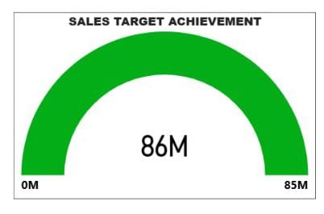
Is the sales target achieved or not?
Why this chart?
❖ Gauge chart is used to track target vs actual performance
❖ It provides a quick visual indication of target achievement status
EXPLANATION
❖ The chart compares actual total sales with the defined sales target
❖ The gauge indicates that the sales target has been achieved
❖ Performance level falls within the success range
CONCLUSION
❖ The sales target is successfully achieved
❖ Indicates strong overall sales performance
❖ Confirms effectiveness of current sales strategies

Slide 19
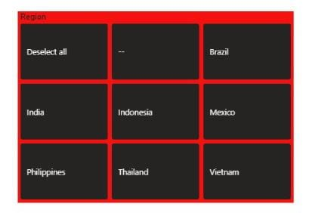
How does sales performance very when a specific region is selected using slicers?
Why this feature?
❖ Slicers are used to filter data interactively
❖ They allow users to analyze region-specific sales performance
EXPLANATION
❖ When a region is selected using the slicer, all visuals update automatically
❖ KPI cards show sales, profit, and units sold for the selected region
❖ Charts display product-wise and monthly performance only for that region
❖ This helps identify high and low performing regions clearly
CONCLUSION
❖ Slicers enable dynamic and focused analysis
❖ They support better regional decision-making
❖ Improve dashboard interactivity and usability

Slide 20

CONCLUSION
The Free Fire Sales Dashboard provides a clear and interactive view of sales performance
It helps analyze sales, profit, product categories, regions, and targets effectively
High-performing products and regions are clearly identified
Sales target achievement can be monitored easily using KPIs and gauge charts
Interactive features like slicers enable region-specific analysis
Overall, the dashboard supports data-driven decision-making and business growth

